Slide 1

Part 1:
Changes Made in Regulatory oversight and their impacts on the dentist,
Part 2:
The testing of the Physician display monitor
September 17, 2026

Slide 2

AGENDA
Part 1
NYS Sanitary Code, Part 16.
The rules and regulations associated with the use of X-rays in the healing arts are covered in the NY State Document known as the Sanitary Code Rule 16. were published on July 22, 2026. It was last revised in1995. It was released for comment in mid April of 2024, and was reassessed. It was revised and sent out again in May 2025. Some of the issues the review group identified were changed, some were not.
It was sent out to the various radiation protection chapters in NY State. It was not sent out to the people it would impact.
Immediately, it is seen as having a significant impact when implemented as written.

Slide 3

Some assumptions in the report that impact the typical dentist
1) about 10% of dental offices have Cone-beam CTs
2) Accreditation of the CBCTs will not have a significant impact on the dentists that have a Cone Beam CT
3) Accreditation will cost about $2,000 initially, updated annually. Full renewal is once every three years.
4) Accreditation should be completed within 18 months of the rule being published.
5) Commitment to the accreditation process must be made by October 20th, 2026

Slide 4
What independent testing is necessary to perform
(b) Quality Assurance Program shall include:
(1) Identification of the facility New York State registration identification number.
(2) Identification of the make and model of the unit.
(3) Identification of the staff trained to perform QC testing and patient care.
(4) Identification of the licensed medical physicist.
(5) The most recent licensed medical physicist survey.

Slide 5
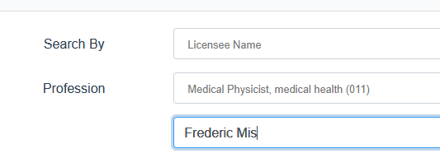
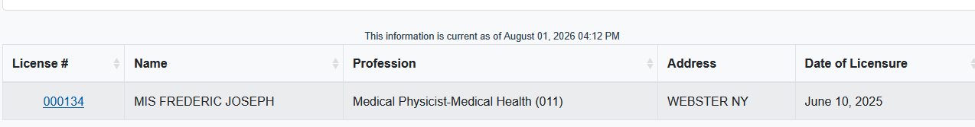

Slide 6
There are two organizations one must deal with under the new regulations
1) The new York state department of health. CBCT use regulations are under Part 16.65 which requires annual testing by a licensed medical physicist as well as an administrative documentation review.
2) The second is accreditation by an independent board to ensure that the operation of a CBCT meets the highest medical standards.

Slide 7
What we noticed immediately:
1) Not 10%, but about 50% of our customers have CBCTs.
2) there are 4 commissions capable of accrediting a CBCT. We have been working with two of them, Radsite and IAC.
3) There is no standard QA test for a CBCT. All manufactures have a version of their own.
4) There is no one standard Testing Phantom that can be used for each brand of CBCT
Note: Each CBCT design has its own test phantom. Carestream’s version is a transparent “Hockey Puck” with various densities of materials Embedded.
Vatech and dexa are similar to that. iCat is very different.

Slide 8
NY State part 16 requirements
Registrant QC testing responsibilities shall include:
(i) For Daily or days of CBCT patient imaging:
(a) Equipment function indicators, mechanical, and other safety checks. This should be documented some how.
(b) Film processing or digital system QC, if applicable.
(c) CT number for water and bone if available.
(d) Field uniformity.
(e) Artifact identifcation.
(f) Repeat or rejected patient images shall be monitored and include the reason for patient image repeat or reject.
(ii) Weekly:
(a) Image viewing system software and hardware – as applicable.
(iii) Ongoing:
(a) Repeat reject analysis as determined by section 16.23(a)(1)(xi) of this Part.
Radiation Safety Training
CBCT Annual Quality Assurance testing and scatter surveys
Display monitor testing
Program overview
Technique chart documentation
Repeat/Reject documentation
Phantom testing with a phantom designed for that unit

Slide 9
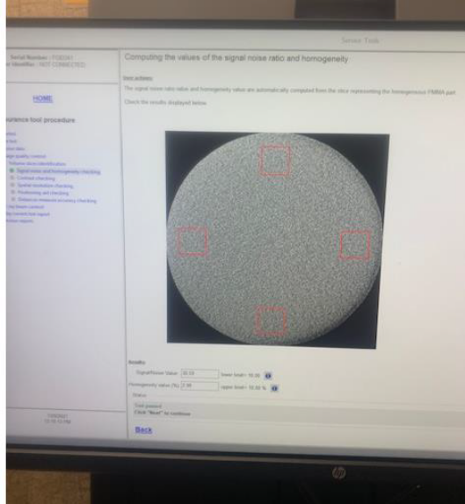
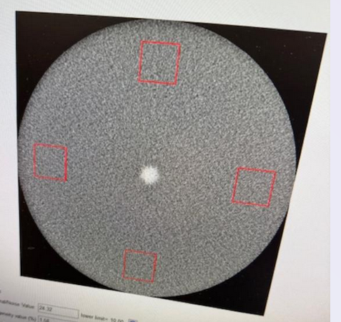
Why test?
CBCTs have a lot of sophisticated image receptors, which age.
They cannot be repaired, only replaced. The top image is what’s expected. The bottom is the start of a significant failure. The bottom image has what is constituted as an artifact

Slide 10
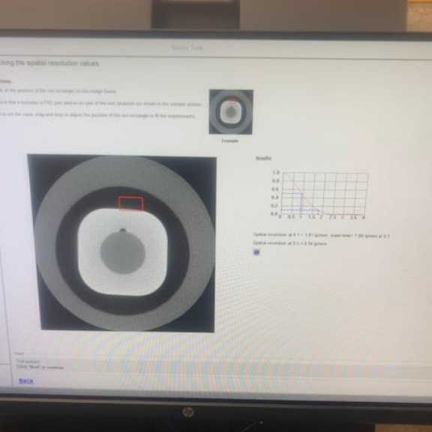
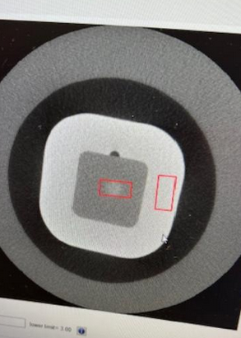
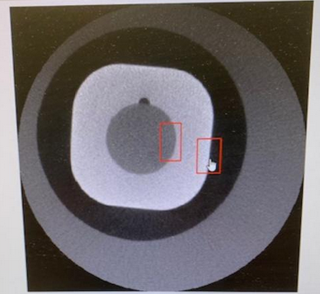
Different densities are displayed as well as indications of proper rotation
There should be no differences in the center gray area, and the rings should be equal thickness for the entire rotation.

Slide 11

Other associated proposed requirements for the use of the CBCT
Dosimetry will be required for the first year of operation, but an area badge may be used instead of individual badge assignments
    Documentation of the area exposure results from a NVLAP approved laboratory at the console or operator location for a duration of one year.
Each cone beam CT unit shall be tested to the manufacturer’s requirements, or a QC test program shall be developed in consultation with the New York State licensed medical physicist if not provided by the manufacturer. My license number is 000134. If you use someone else, confirm they are licensed!
Calibration of the CBCT unit. The radiation output calibration of a CBCT x-ray system shall be performed with a calibrated dose monitoring system (A dose monitoring system is what the physicist uses to determine the operating characteristics of the CBCT)

Slide 12
Shielding of the CBCT radiation
Based on the National Commission of Radiation Protection (NCRP) documents 145 and 147, 90% of the radiation is shielded or scattered by the patient. The scattered radiation must still be considered.
Some of our measurements have indicated that the staff receive sufficient radiation dose that they cross the threshold for radiation monitoring, (500 mrem per year) and that the walls must be shielded to reduce the dose to the general public to less than 100 mrem per year.
Creating radiation fields to these levels puts the owner into what we call regulatory space, and action is then required to ensure that these limits are not exceeded.
Note: The limit of exposure to the declared pregnant operator is 5 mSv (500 mrem) per gestation period. We have had several discussions with staff who have expressed concerns to us about the higher levels of radiation from the CBCTs.
If a shielding study was performed for your office, make sure you have a copy of it. If MIS, Inc. did it for you, we have a copy in our files if you can’t find yours. If you don’t have a shielding study, we will develop one for you.
Note the requirement: A medical physicist shall “Perform a radiation-protection survey documenting that an appropriate shielding plan exists, that required shielding is installed, and that the shielding plan has been updated if significant facility or operational changes have occurred since the plan was developed.”

Slide 13
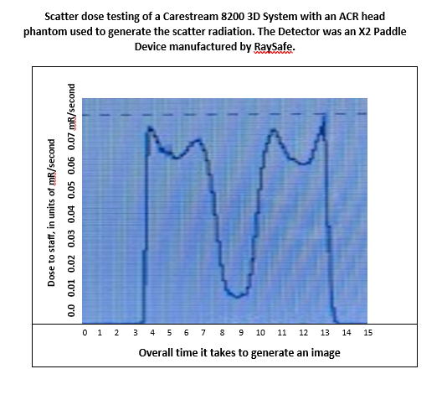
Below is a simplified version of what we have measured during CBCT radiation surveys

Slide 14
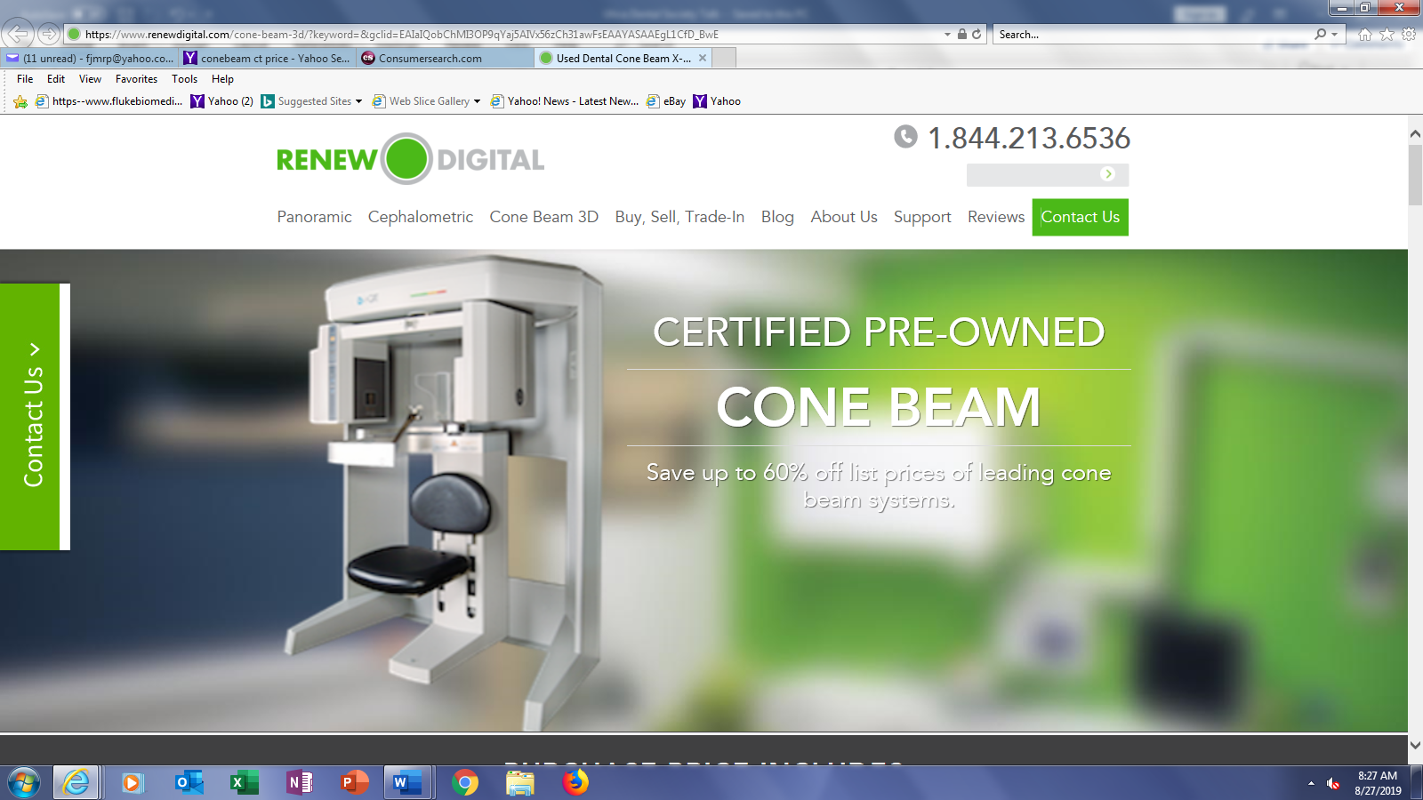
For an Older CBCT unit, Significant scatter radiation may be a concern!

Slide 15
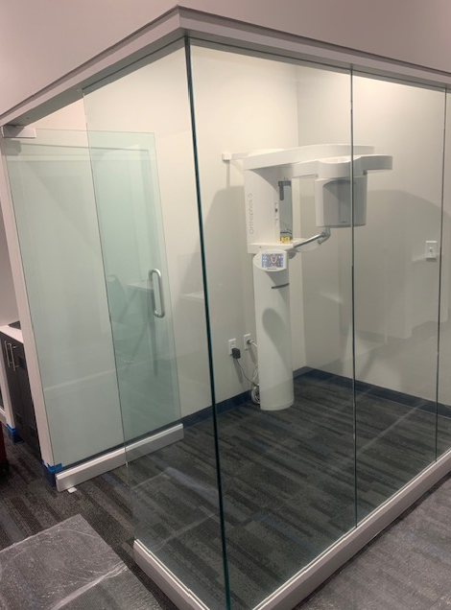
A Shield Design that “Shows off” the new technology
Protective measures for staff are taken because of the higher amounts of scatter radiation from the workload, and higher energies. This has to be balanced with the dentist’s wishes to demonstrate their devices. This enclosure is 0.75 inches of glass, opposite (where the image was taken from) sit 2 female administrators, late twenties or early thirties, who had many concerns about the scatter radiation. Area badges were installed to confirm the success of the shielding and assumptions used in the calculations.

Slide 16
Training
documentation of initial and annual training completion shall be maintained for a period of three years and be available upon request.
The practitioner shall attest in writing to the employee’s completion of initial and annual training for each qualified employee allowed to operate the CBCT

Slide 17
Some things the State and accreditors should consider
Acceptance Criteria
Vatech has recently modified its QA software to be more consistent with the New York requirements
When contacted, none of the CBCT vendors have a test head phantom yet that meets all of the current State requirements. Carestream is considering developing one, but is resisting incorporation of CT numbers.
Other states, who have CBCTs, do not have these standards , but are watching NY to see the implementation results.(Note: Colorado is also updating its regulations and have none of these requirements.)
NJ in particular may be next to accredited it’s CBCTs.
NY city rules does not require Accreditation! It operates separately from Albany!
Dosimetry and training of new employees
  We have many years of exposure history documenting a lack of radiological exposure to the operator when the install is done properly. Area dosimetry is an acceptable alternative to personal dosimetry
  We now know that the dental office may provide annual training as well as training to new employees as long as the trainer has 3 hours of training on the CBCT unit as well as experience with it.

Slide 18
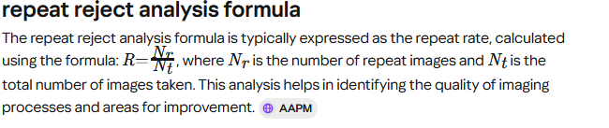
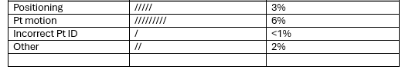
What is the required repeat reject analysis?
Quality Improvement — Regular analysis of repeat and reject rates can lead to enhanced imaging quality and reduced costs.
Data Collection — Accurate data collection is essential for effective analysis and should include reasons for repeats and rejects
.
Type of error | Number of events | % of total errors

Slide 19
Typical required internal testing frequencies. Please ensure you have a tracking system to prove you are doing the required testing!
Carestream: Monthly
Vatech: Monthly
Sirona: Monthly
iCat: weekly
Others, including Planmeca are not as clear.
Each vender has their own testing phantom and procedures. The installer should provide the initial training on how and when to do the QA testing.

Slide 20
Accreditation, Who can do it?
Who is recognized as accredited for dental devices? Why is accreditation required for dental offices?
This may drive the number of CBCTs taken higher in order to make up the difference in costs from accreditation!
My organization has been testing CBCTs for more than 10 years.
We have seen that most offices average less than 10 CBCT images per week, typically one or two.
We have learned that some dentists are seeking ways to disable their CBCT technology in order to avoid the accreditation effort. Albany has still not provided guidance on what is required to demonstrate that a CBCT has been taken out of service. (i.e. software changes, physical detachment, professional attestation, etc.)

Slide 21
Accreditation, Why?
Is it linked to the Affordable Care Act, which requires insurers to reimburse only those facilities who have accredited programs?
If so, why are other States capable of performing services without accreditation
The thoughts are that NY wants to be able to include dental care in most insurance plans which as defined by the Affordable Care Act, requires that all aspects of a program be accredited.
Currently we have been working with two accrediting bodies
RadSite
The contact is Kristen Dahlander, M.Ed.
443-372-8999
Kdahlander@radsitequality.com
www.RadSiteQuality.com
2) The Intersocietal Accreditation Commission (IAC)
www.intersocietal.org/programs/ct-dental-ct/ standards
Contact is Nancy Davis.

Slide 22
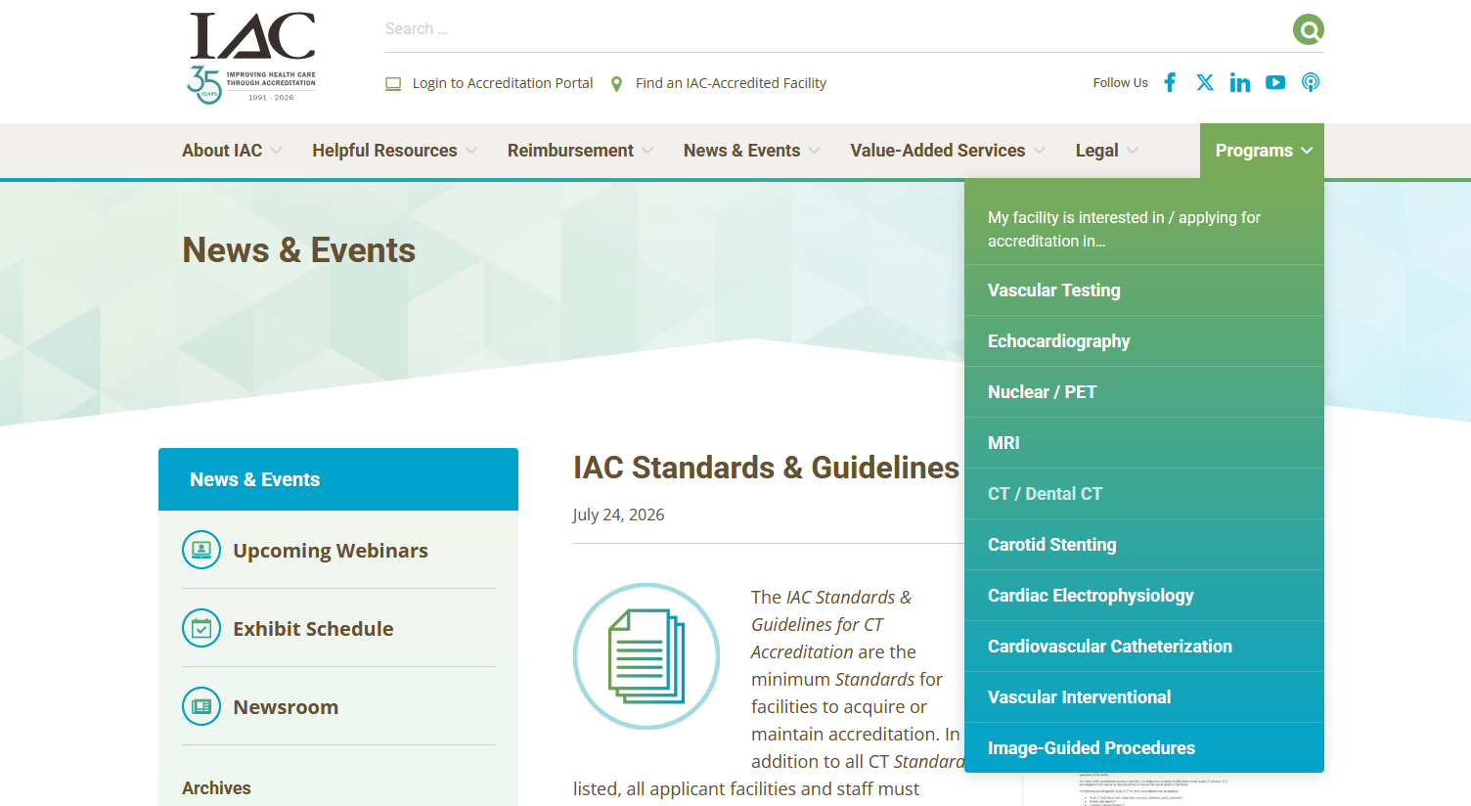
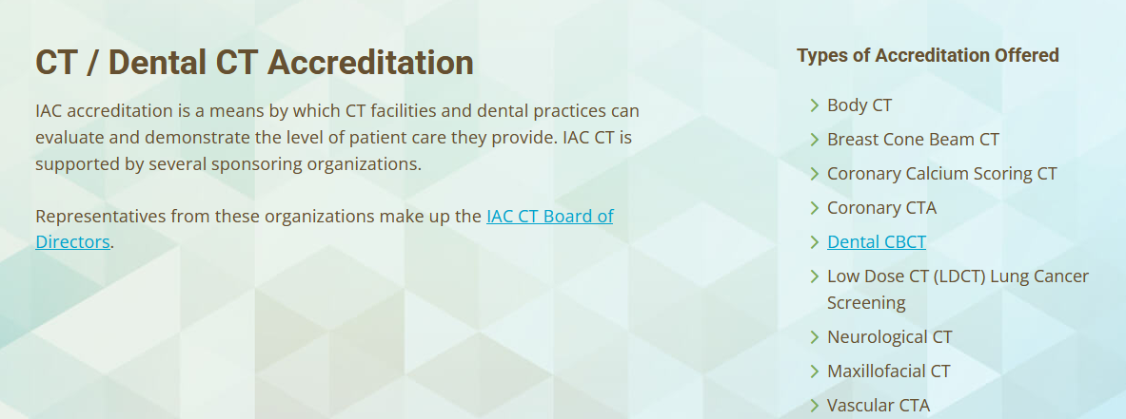
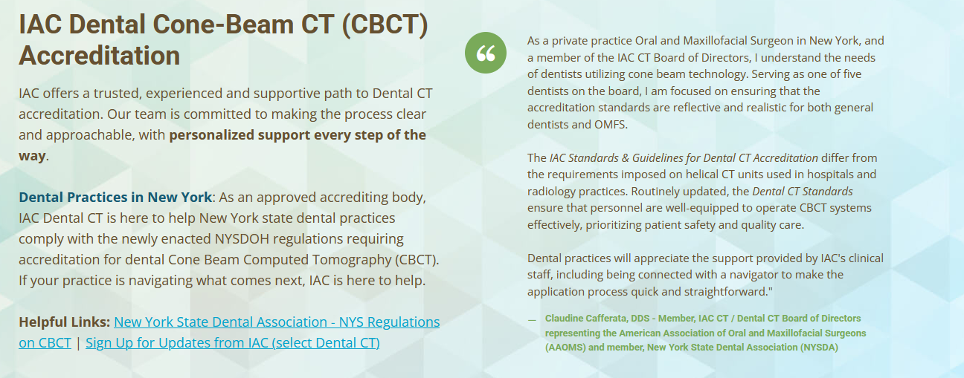
The IAC Website is not intuitive

Slide 23
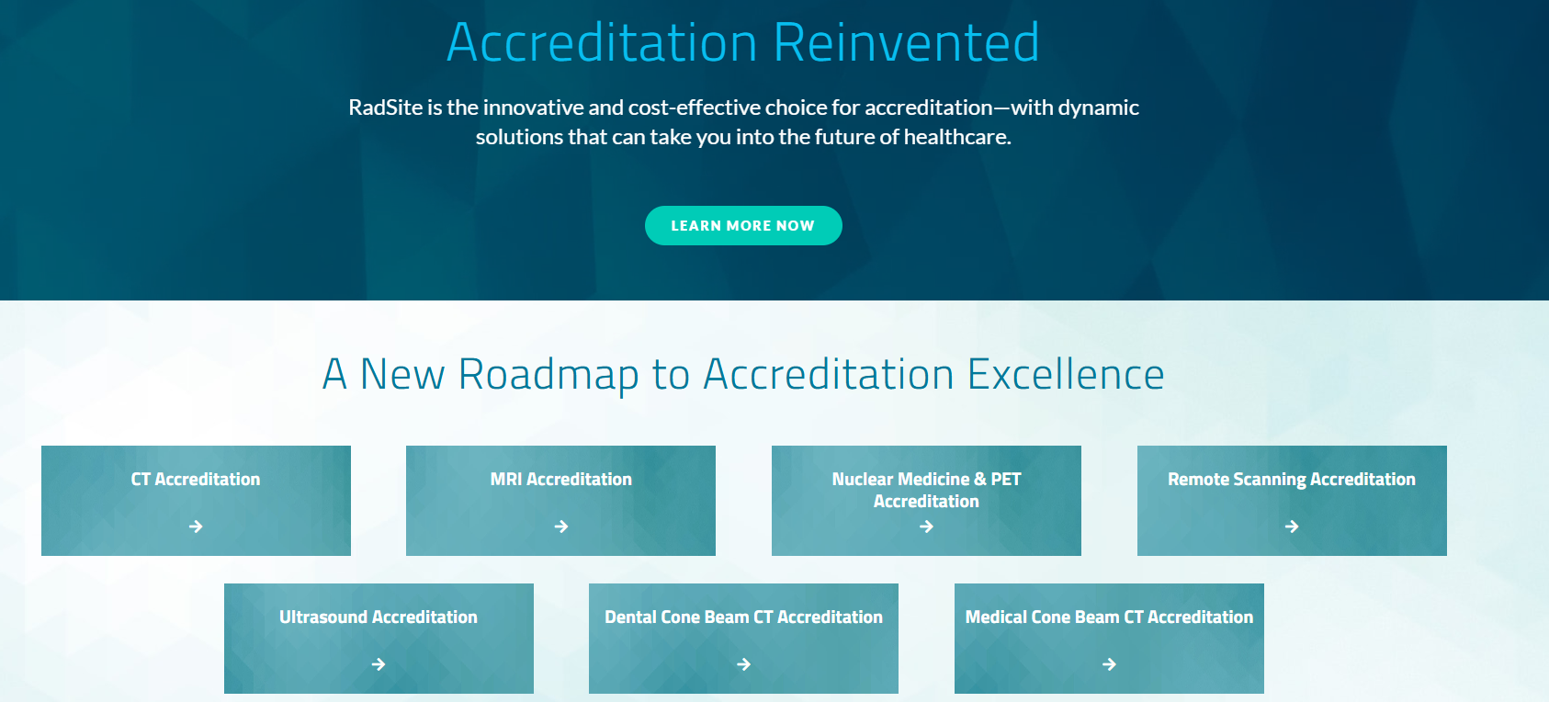
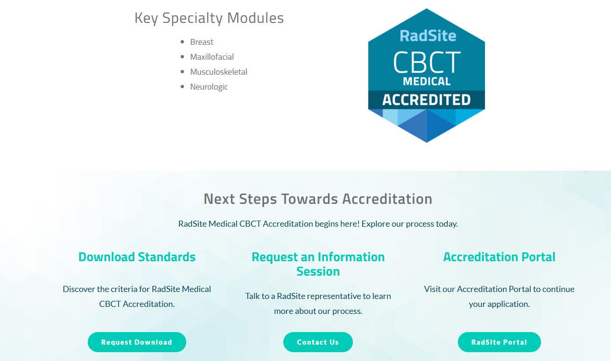
The RadSite is more intuitive

Slide 24
When are you required to be accredited?
The clock starts Oct 20, 2026,
After that date new licensees or registrants will have 18 months to become accredited and must demonstrate that they have initiated the accreditation process within 90 days of the start of operations.
A facility performing CBCT scans that loses their existing accreditation or a registrant or licensee that fails to obtain accreditation must report this fact within 30 days to the department.
It is not clear what Albany’s response will be for anyone who flat out refuses.

Slide 25

What is the IMPACT of these changes on site training programs and data interpretation?
(i) Basic radiation principles and safety is required (3 hrs) is now required by staff who operate the CBCT.
(ii) Machine model specific training.
(iii) Displays and systems used for viewing.
This is required testing on the display monitor used to interpret images from the Panoramic/CBCT unit
(iv) Documentation of initial and annual training completion shall be maintained for a period of three years and be available upon request.
(v) The practitioner shall attest in writing to employee completion of initial and annual training for each qualified employee allowed to operate the CBCT.
.

Slide 26
What about the staff and their training?
Even though the IAC standards and RadSite indicate all staff must be credentialed in some way, they defer to the NYS Dept of Education and NYS Dental Association which indicates dental assistants do not need DanB (or any other type) of certification.
However, your records on employees should indicate years of experience and any specific training in place of a certification.

Slide 27
FINAL TAKEAWAYS on Part 16 changes
The rules appear to have been written by someone with little or no dental imaging experience.
They appear to have been written for whole body X-ray units, operating in a hospital or large imaging facility
I don’t envision dental hygienists enjoying the daily QA testing
You should contact your vendor, and see if they are preparing, or even aware of the impact on your operations:
Vatech is, Carestream is, I have yet to hear from iCAT
Planmeca has met some of the requirements.
Benco is aware of the impacts from this legislation.
I am not heard back from Henry Shine, but I assume that they are aware of the new rules.

Slide 28
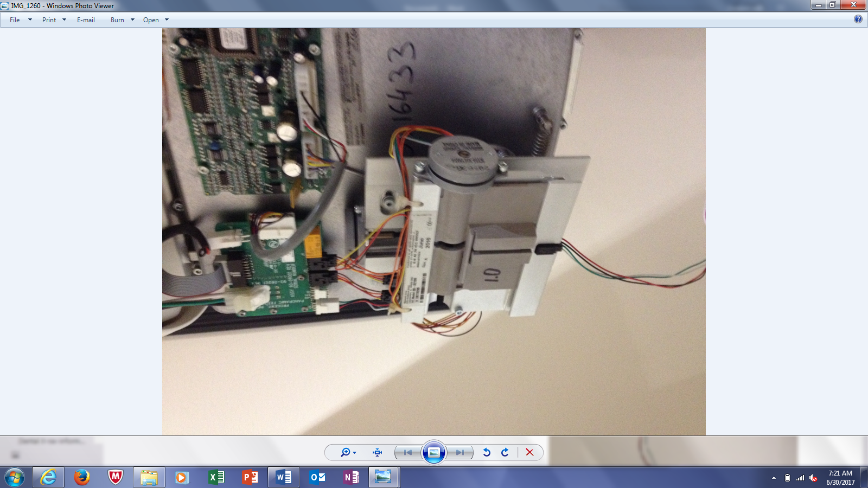
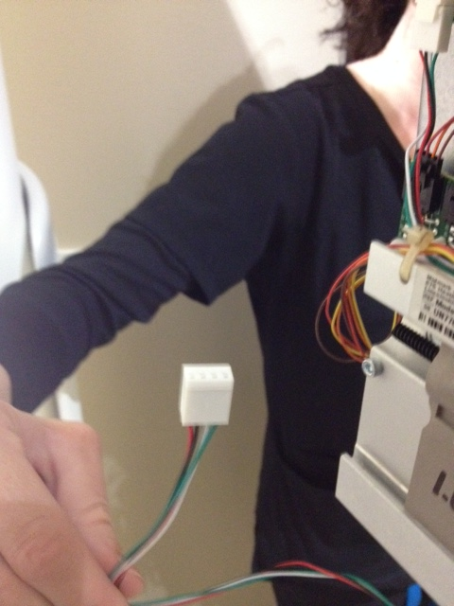
Why we test. What can go wrong with your CBCT?

Slide 29
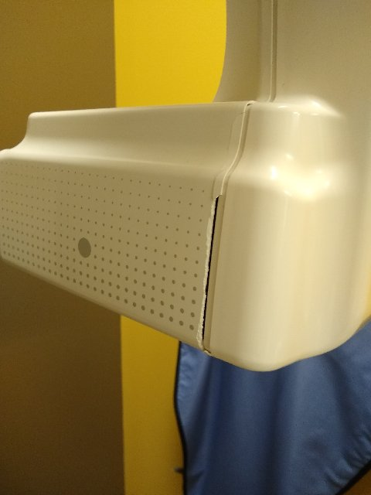
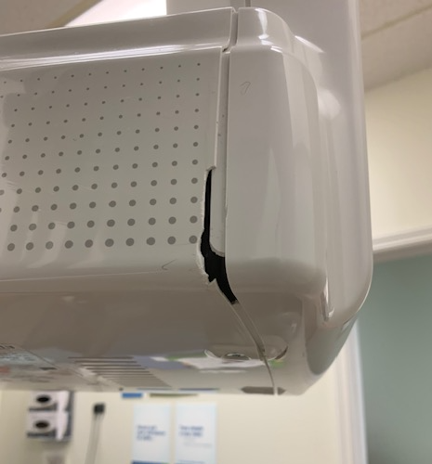
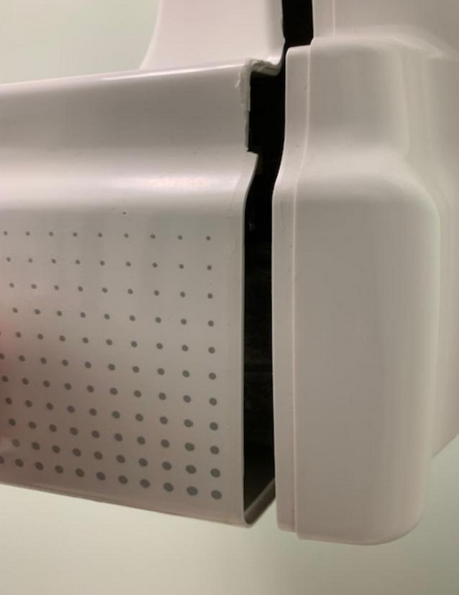
What else can go wrong: Radiation embrittlement!
The first image is cracking of plastic covers due to aggressive cleaning combined with radiative damage to plastic. During Covid-19 peak, aggressive use of bactericides coupled with radiation induced weaknesses on the plastic casing resulted in case cracking and the exposure of significant electrical components. This resulted in occasional creative, homemade fixes which would never be approved by the FDA.
I frequently remind the staff that the power within these units is not 120 volts, but 120 thousand volts. Do not put fingers into the openings.

Slide 30
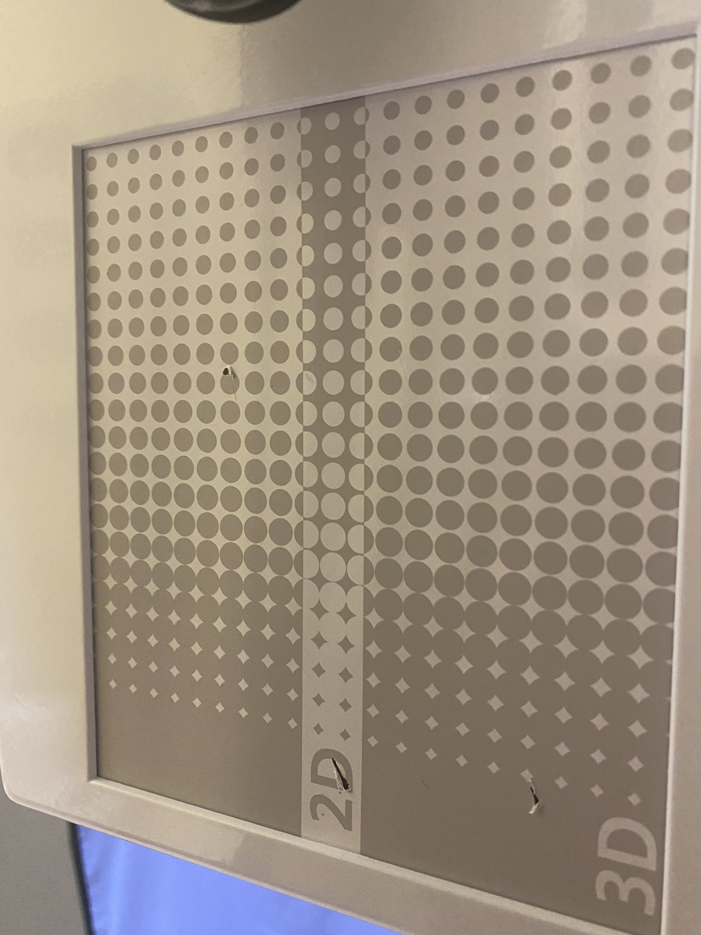
Damage caused by curious staff, or on purpose?

Slide 31
it is incumbent for you to periodically review the status of the condition of your CBCT!
If you notice something, you can call me and we can discuss options on the phone.
Home repairs, using packing tape or your glue of choice, are not acceptable or FDA approved repair processes.
Deteriorating image quality is one indication of tube failure.
If your operating manual calls for an internal testing frequency, then follow it.

Slide 32
Part 2: Physician Display Monitor
There are now regulations in NY State which require testing of Physician Display Monitors for dental offices, and there are a few things the dentist can do to improve their ability to provide the best possible diagnostic abilities at very little cost.
Society of Motion Picture and Television Engineers (SMPTE) patterns are available on the internet and can be used to determine the effectiveness of the display monitors.
Specific tools and training are required for whole body diagnosis using X-rays, but a simple review by the dentist on a regular basis can help them determine the quality of their imaging systems.
We suggest that you download a typical SMPTE pattern and we will test the monitors using specific testing criteria. This is best done when the monitor is new and we can track the monitor performance over time. There are specific tools designed to measure the differences over time.

Slide 33
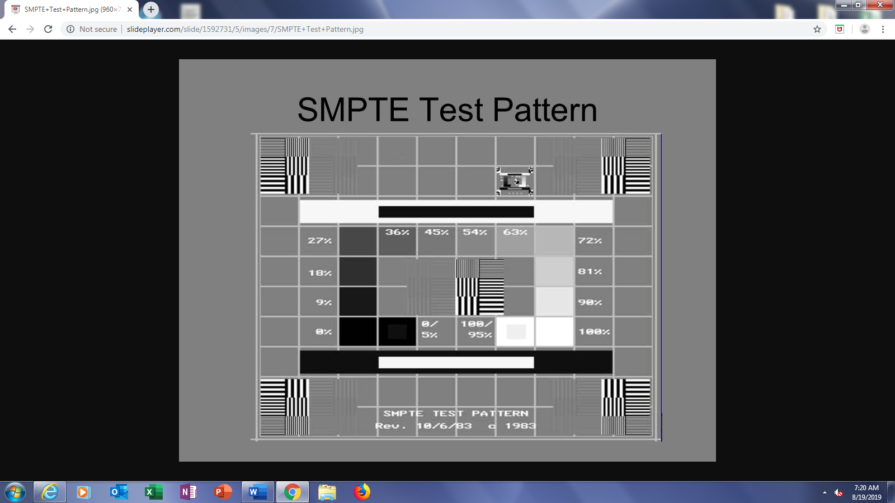
Found on the internet for free

Slide 34
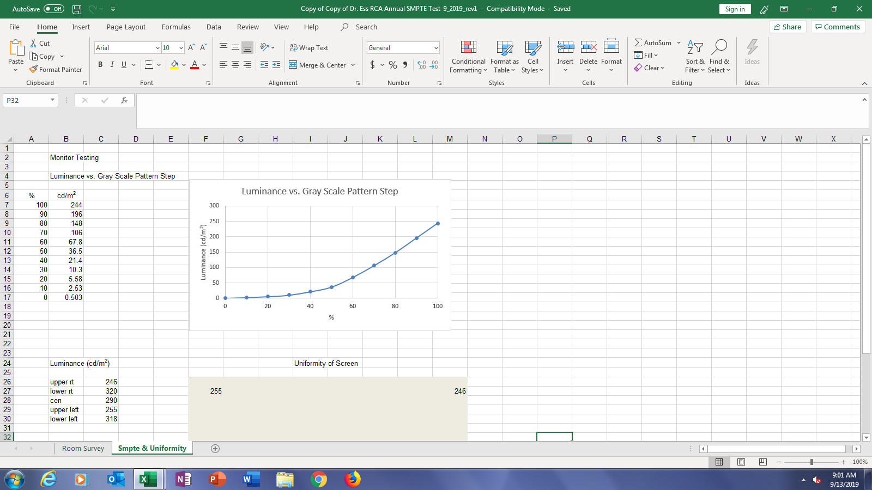
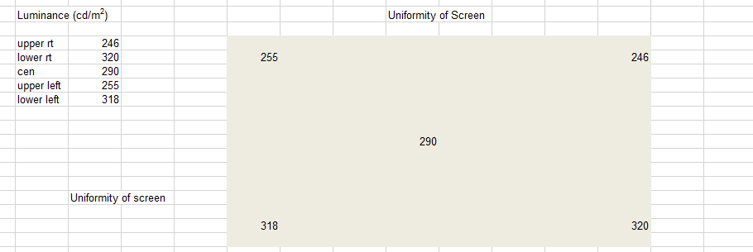
What we measure for on the monitor

Slide 35
A Quick Note on Ownership Changes
This came up from the State of NY DOH recently.
An office changed hands; the displayed registration referenced the previous owner.
The report had the NY State permit number of the previous owner, and when reviewed by the NY State, our testing report was rejected.
The office in question was contacted, and was told that
They need to complete the registration process,
Because the radiation survey was performed more than 365.25 days ago, (actually 2 years ago), the needed a new survey of their office.
3) If you become accredited and sell the office, you cannot sell the accreditation!
We used to be able to lobby to the State that a survey less than 2 years old was good enough. Not anymore.
If you know you are selling or changing the name, please contact the State (or us) ASAP. We will guide you through the process.
This is happening so frequently now, the State has got the process down pat. There is little leeway being given.
Contact us if you want some help making changes, we’ve seen a lot!

Slide 36
How can Multi Industrial Services help you?
MIS, Inc. can help offices walk through the process, including providing the required 3 hrs CE for Radiation Safety Training in addition to shielding designs, monitor inspections and full office inspections. Our training program for the 3-hour radiation safety portion is under final review and will be ready after the October 20, 2026 start date. We can assist you in the package preparation, as well as performing the required radiation safety training.
Note that if you have had an inspection prior to the issuance of the new regulations, the next one, with all of the new rules incorporated, will be the one which will be submitted for review.
The RadSite and IAC have also indicated that applicants will have a "Navigator" who will be assigned to help them gather the required documentation. The accreditors recognize that this is a unique situation and will assist an office in the process at no charge.

Slide 37

THANK YOU
Dr Frederic J. Mis, Ph.D., CHP, LMP 000134, NY State CRESO 150
Multi Industrial Services
585-797-4578 (Me), fjmrp@yahoo.com
585-727-9225 (Sue Schoen, my associate)
585-236-0068 (office number)

